Slide 1
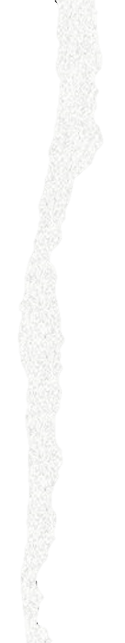

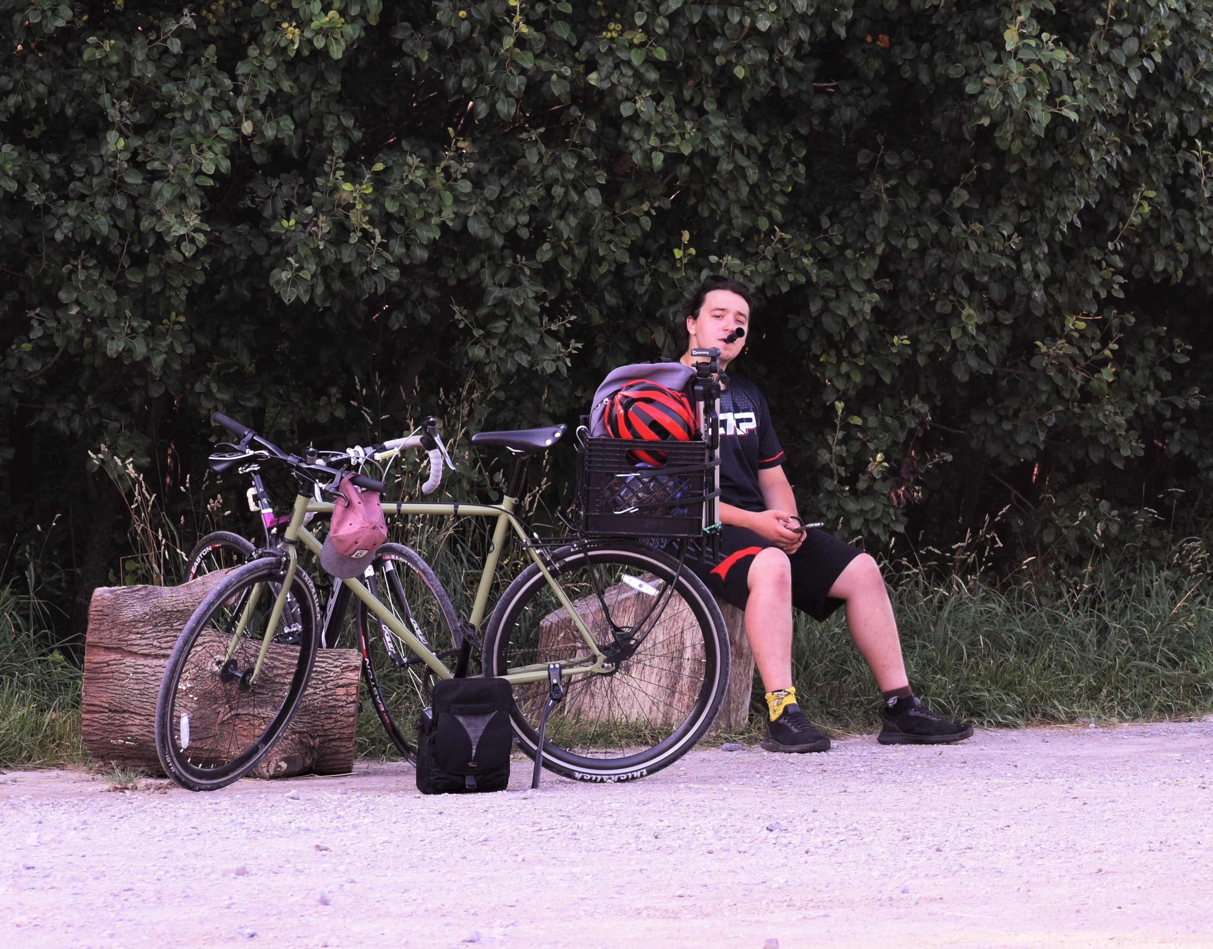
Alex Popescu
M.Sc. Student in the Gotanda Lab
Likes crows… a lot…
Reachable at apopescu@brocku.ca or in MC F209
→ Please put “BIOL 2P92” in the subject line
→ Won’t answer emails 12h before due dates

